Slide 1
Shepherd Of The Hills
Facility Expansion Goal:
Start Construction by 2022

Slide 2
Open, Inviting, multi-use lobby

Slide 3
Fellowship Hall Seating Up To 175

Slide 4
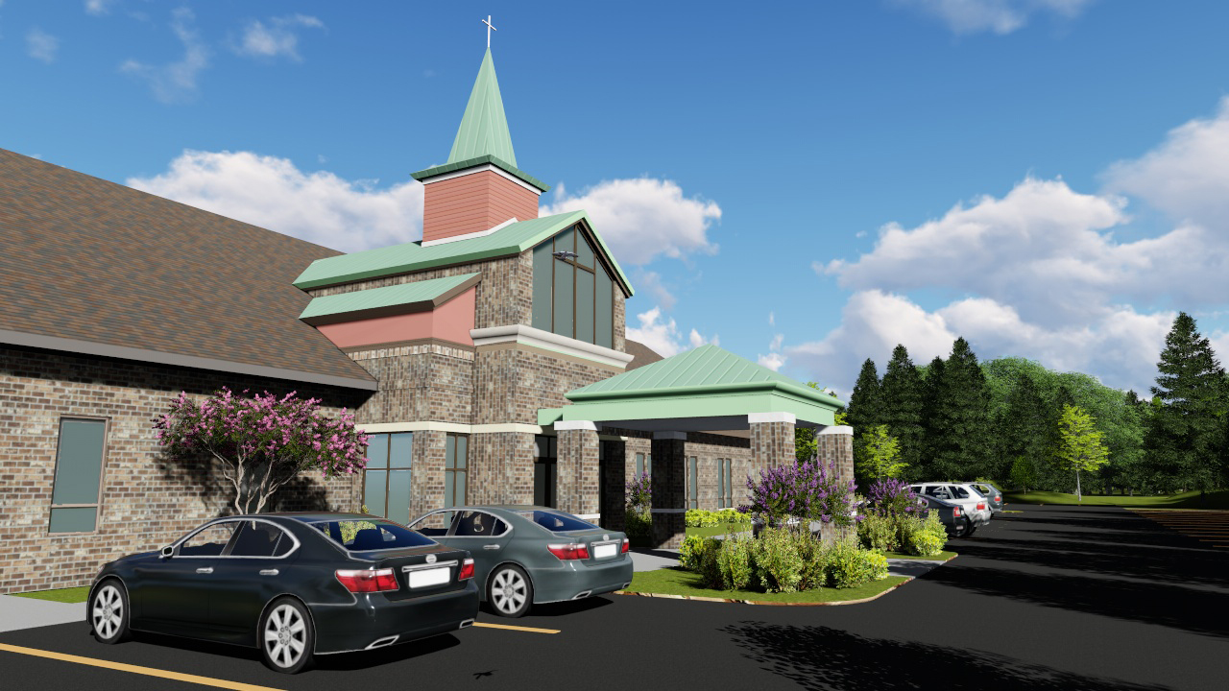
Highly Visible & Inviting Entrance

Slide 5
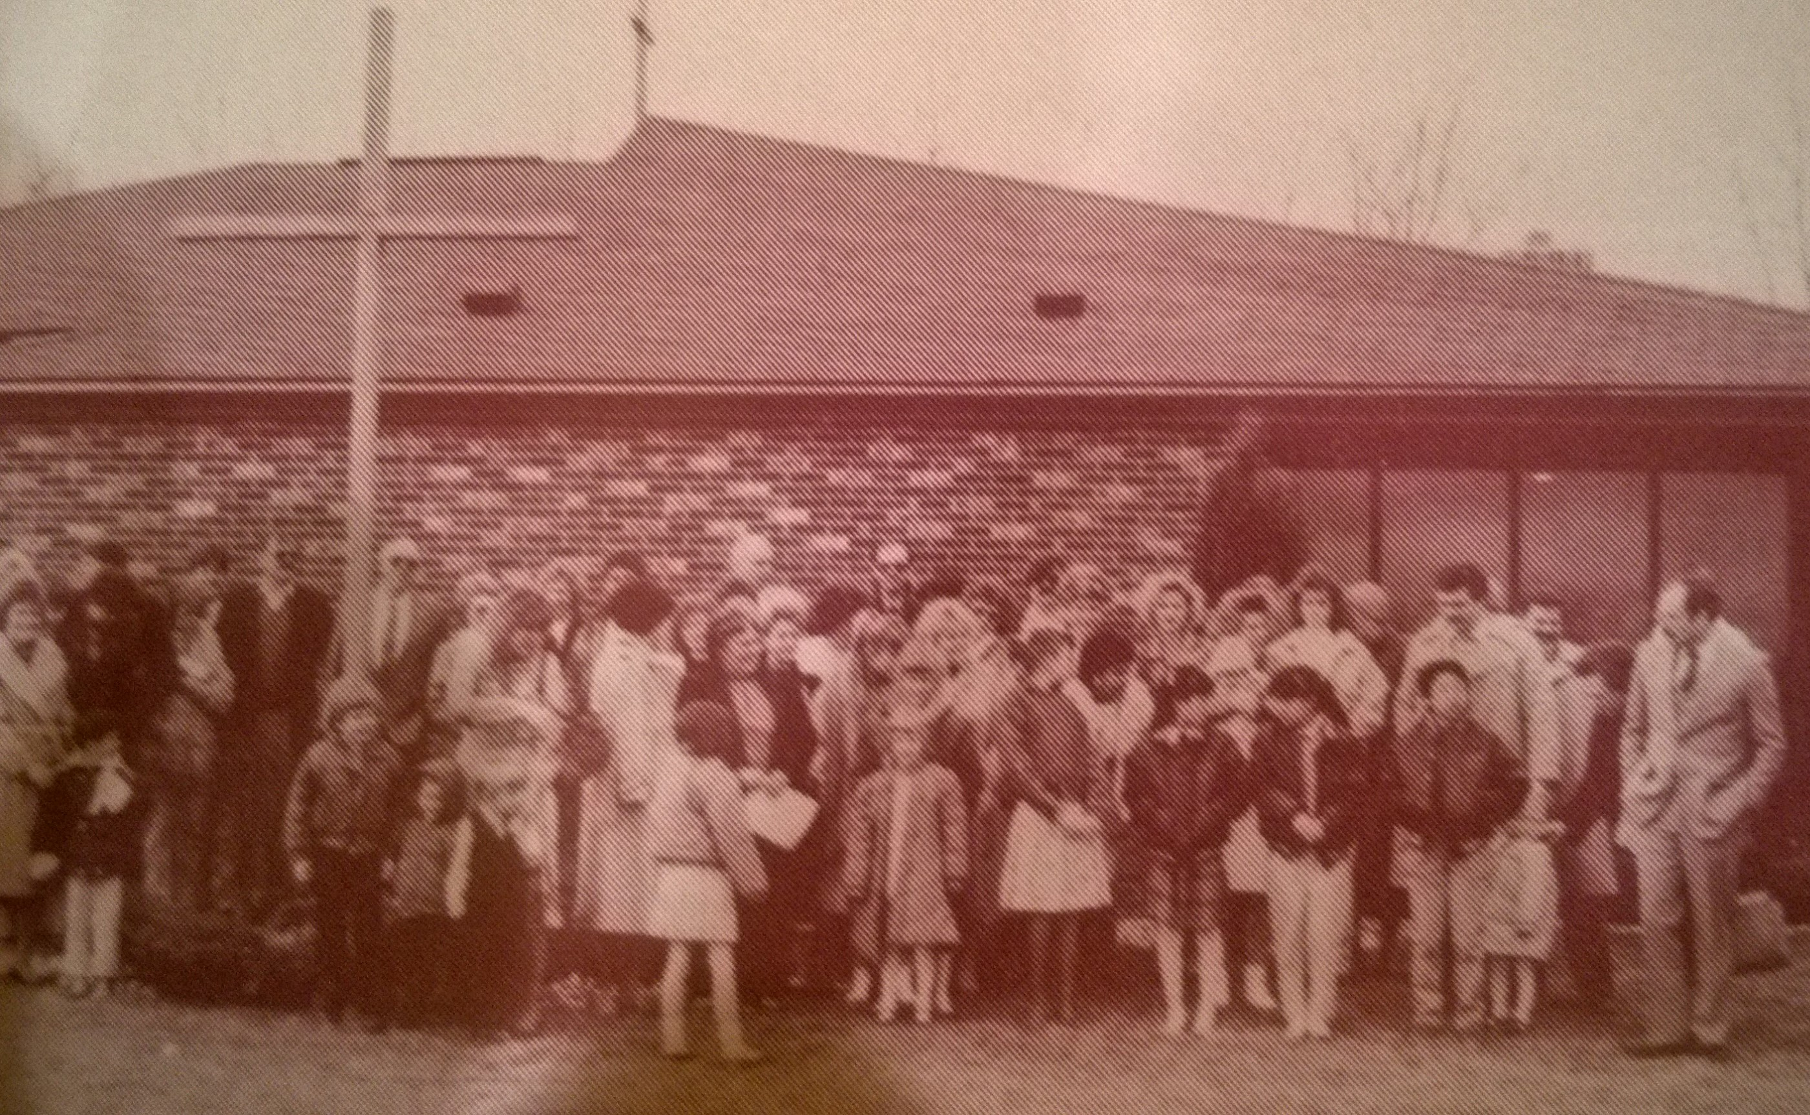
They Sacrificed For Us & Others

Slide 6
Now it is our turn; our privilege!

Slide 7
Total Project Cost: $1,500,000
Down Payment Target: $800,000
Building Fund To Date: $300,000
Contributions Needed: $500,000
2019: $125,000 2021: $125,000
2020: $125,000 2022: $125,000
2022: $800,000 down payment achieved

Slide 8
How Am I Going To Do That?

Slide 9
We are not a small congregation!
160 regularly worshiping individuals/family units
Giving $781 per year =
$125,000
(Annual Building Fund target)

Slide 10
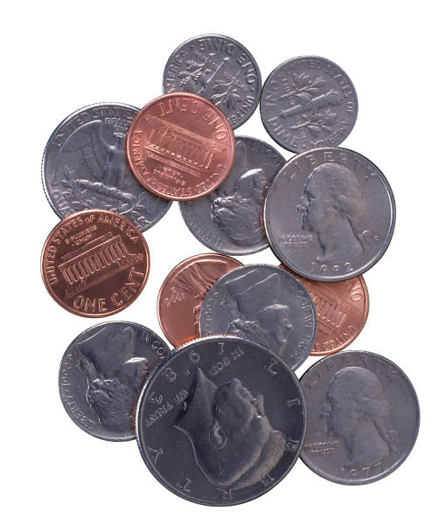
$781 / Year is…
$65/month
$15/week
$2.13/day

Slide 11
The 6% Blessing
Median household income (Lansing) $53,300
6% of $53,300 = $3,198
$3,198 x 160 individuals/couples = $511,680
$511,680 Projected Offerings at 6% of income
- $365,000 Current General Fund Budget
- $125,000 Annual Down Payment Target
+ $ 21,680

Slide 12
Each of you must bring a gift in proportion to the way the LORD your God has blessed you. Deuteronomy 16:17
Honor the LORD with your wealth, with the firstfruits of all your crops. Proverbs 3:9
Grateful Proportionate First Fruits

Slide 14
New Ways to Give Online/Electronically

Slide 15
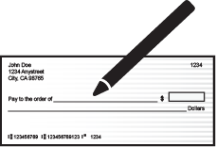
Why Give Electronically?
Provides convenience for you
There is no need to write checks or bring cash to church when contributions are made automatically. Your contributions are transmitted electronically and are deposited directly into the church bank account.
Before
After

Slide 16
Why Electronic Giving?
Why Give Electronically?
Keeps you on track with stewardship commitments
Scheduled, automated offerings prevent you from falling behind on financial pledges.

Slide 17
Why Electronic Giving?
Why Give Electronically?
Guarantees your uninterrupted support
Even the most committed churchgoers will occasionally miss services—and weekly offerings—due to illness, poor weather or vacation.

Slide 18
Why Electronic Giving?
Why Give Electronically?
Provides you with today’s most popular payment methods
Many families—especially young families—rarely write checks or carry cash.
ACH
Credit and Debit Cards
Online Giving

Slide 19
Why Electronic Giving?
Why Give Electronically?
It’s good for our church!

Slide 20
Why Electronic Giving?
Why Give Electronically?
Provides much-needed donation consistency for our church
Seasonal donation slump is reduced
Financial forecasting is improved
Planning can proceed with confidence
Before
After

Slide 21
Why Electronic Giving?
Why Give Electronically?
Saves church staff time
As the effort required to process cash and check donations decreases, the efficient use of staff time increases!

Slide 22
Why Electronic Giving?
Why Give Electronically?
Adds greater security in the church office
Reduces handling of checks and cash.

Slide 23
How to Donate Online
How to Give #1
Go to SOTHLansing.org
Click on the “Give Online” button

Slide 24
How to Give #1

Slide 26
How to Give #2 – Phone App

Slide 27
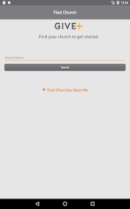
Donate through GivePlus App
GivePlus App

Slide 28
How to Give #3 - Texting

Slide 29
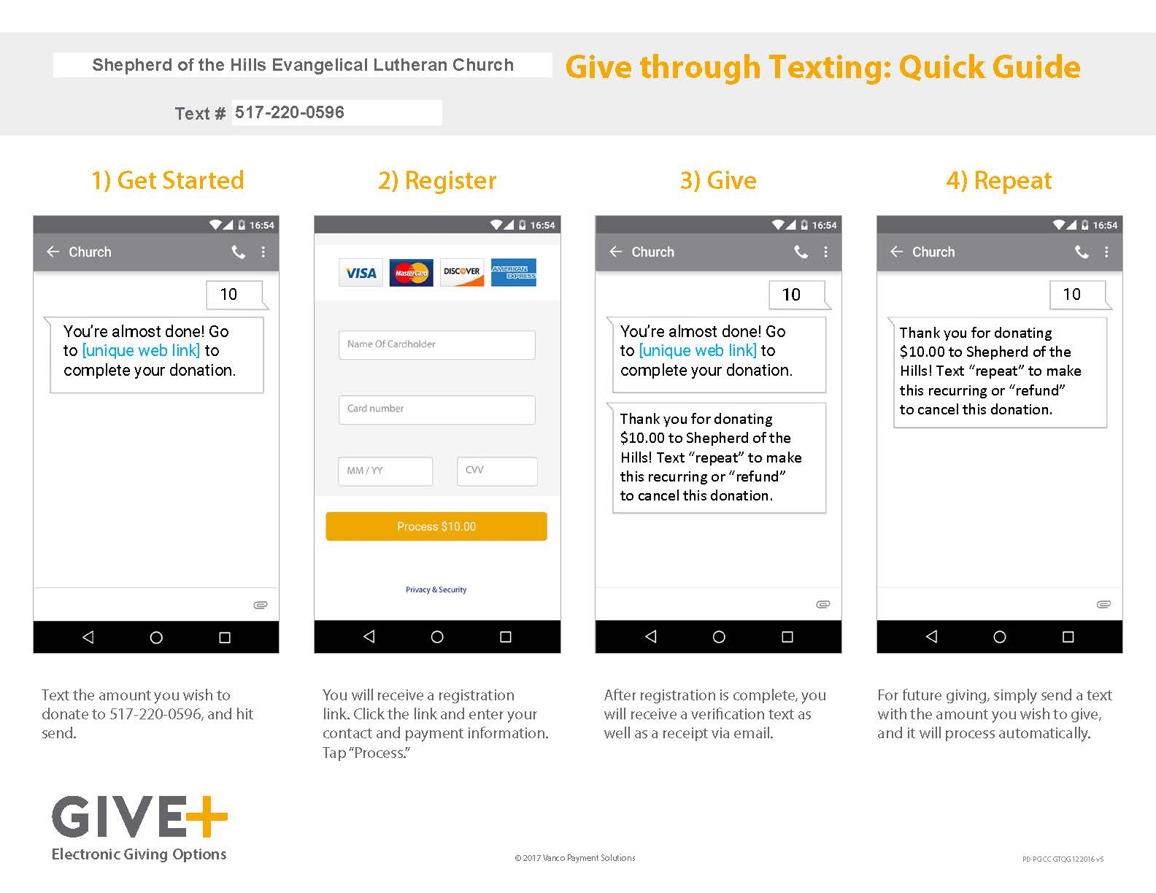
Donate through Texting

Slide 30
You Can Continue to Use your Offering Envelopes

Slide 31
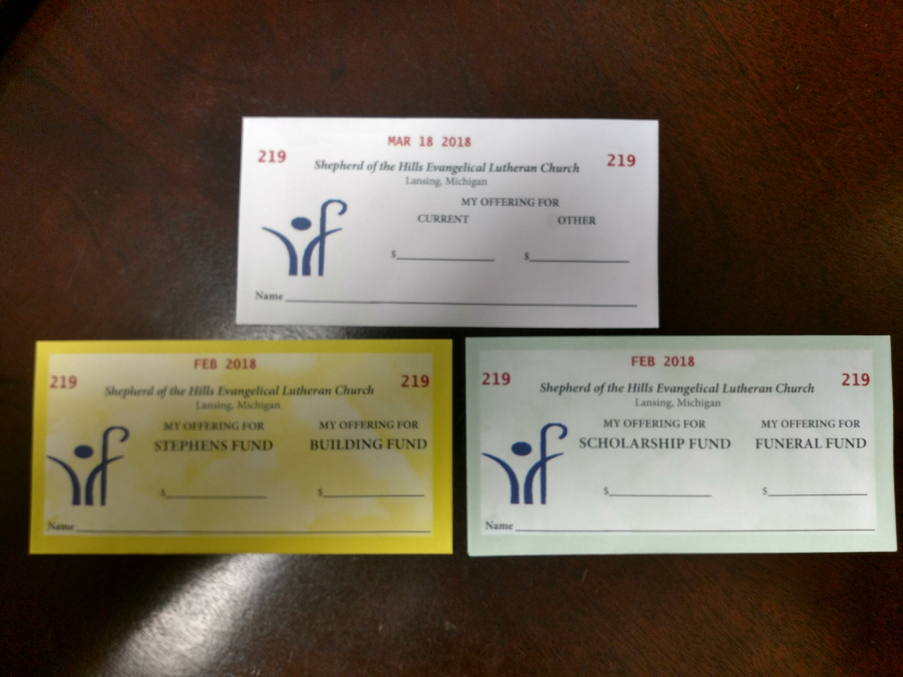
Donate the Same Way You Always Have

Slide 32
Information has been placed in your mailbox
Information will be emailed out to the flock
Information has been placed on the bulletin boards in the narthex
Future bulletin blurbs will have this same information

