Slide 1
Five Year Plan 2017-2022
Shepherd of the Hills

Slide 2
Opening Devotion: 1 Corinthians 1:7
“You do not lack any spiritual gift as you eagerly wait for our
Lord Jesus Christ to be revealed.”
What gifts do we need to do God’s work that he has given us?
Two key questions:
a) Are we using God’s gifts faithfully?
b) Are we being fruitful in our ministry?
What will always be the answer to those questions?
How does the last part of this verse motivate us?

Slide 3
2013-2018 Ministry Plan: Christ@Home
In My Heart: Email devotions/ Book fairs / did not do online studies as planned / Bible Class attendance up 50%
In My Family: Lenten & Advent children’s devotional resources / parent and couple emails / marriage enrichment workshops
In My Church Family: Small group Bible studies / shared interest groups / food and fellowship time after 10:30 service

Slide 4
2013-2018 Ministry Plan: Outreach
We expanded senior outreach to 13 facilities (our goal was 6) but struggled to mobilize visitor volunteers
We did not achieve 4-5 children’s outreach events/year
We initiated annual teen mission trips
We struggled with canvasses (our plan was 4/year)
Recently doing more to support WELS campus ministry

Slide 5
2013-2018 Ministry Plan
We made slow progress on facility expansion
Communicant membership increased (245-254) but worship attendance declined (245 to 216/Sun)
Of 454 current members, 90 do not worship at SOTH
48 stopped coming 21 moved away
7 have faith/unrepentant sin issues 14 shut ins
Faithful efforts have been made to encourage regular worship and engage members in ministry

Slide 6
The Planning Process
September/October 2016:
Community Profile, Congregational Profile, Pulse Survey
November/December 2016:
Bible Study on ministry and ministry evaluation
January/February 2017:
Council & board internal evaluations /Review of data / SWOT assessment /development of 5 year plan

Slide 7
SWOT Assessment: Strengths
Two Pastors who faithfully teach Word / Dedicated Admin. Assistant / Spiritually mature leaders willing to self-evaluate and change
Friendly, demographically balanced congregation
Senior ministry in 13 senior facilities
Active women’s ministry group
Many gifted people care about and are engaged in ministry
Wide range of Bible studies and personal electronic study options
The congregation has no debt and is financially stable

Slide 8
SWOT Assessment: Weaknesses
We try to do too much, failing to achieve plans
We don’t always work the ministry plan as we could
Leadership/volunteer recruitment and training can improve
Leadership communication can be better
Participation in outreach events and programs is weak
Worship attendance is trending down
Room for growth in financial stewardship/giving
Facility is limiting our ministry

Slide 9
SWOT Assessment: Opportunities
We have the saving truth of God’s Word to share with a dying world
Millenials and seniors form large demographic groups with specific opportunities to share the gospel
Teen ministry can grow from a core of enthusiastic young believers
Facility expansion can help us reach more people with the gospel
Newly acquired property gives us new ministry opportunities
People are asking for training for sharing their faith
We have many young families on which to build children / marriage / family ministry

Slide 10
SWOT Assessment: Threats
A self-satisfied “status quo is fine” mentality in congregation
Increasingly ungodly culture affecting our attitudes or lives
Not adapting how we minister in a changing culture
A “we should do that” recognition of needs without acting
Changes (e.g. facility expansion) leading to bickering or division
Retention of only 1/3 of our young adults
False assumptions about Christians in our culture
Technology leading to people isolating versus gathering

Slide 11
Revision Of Mission Statement
CURRENT: “Believing that God has called us to “go and make disciples of all nations” (Matthew 28:19), we at Shepherd of the Hills will share God’s Word through daily contacts and outreach to the community and beyond, while providing a caring and nurturing atmosphere in which to learn more about our Savior and to better serve him.”
PROPOSED: God has called us to “go and make disciples of all nations.” (Matthew 28:19) Therefore…
The family of God at Shepherd of the Hills exists to share the love
of Christ and proclaim his gospel to people near and far for the
salvation of their souls.

Slide 12
Core Values
Worship (We exist to “Proclaim his gospel”)
God’s Word and Sacrament are the means by which God creates and preserves saving faith in Jesus Christ. Therefore, we will gather weekly for worship around the Means of Grace to grow in our faith and to give thanks to God through our prayers, praise, and offerings. (Hebrews 10:25; 1 Corinthians 10:24,25) Valuing the blessings of the gospel, and desiring to glorify God, we will strive for excellence in how we conduct worship services and how we demonstrate Christ’s love to all fellow worshipers before, during, and after the service.

Slide 13
Core Values
Discipleship (We exist to “proclaim his gospel to people near”)
Christians want to grow in both their Christian faith and also in their Christian living. We value the pure Word of God as the means for such spiritual growth. We will offer regular Biblical teaching and training so that God’s people, young and old, might grow in faith and be equipped to joyfully serve Christ and others to the best of their God-given ability. (Matthew 28:19,20; 2 Peter 3:18; 2 Timothy 3:16,17)

Slide 14
Core Values
Fellowship (We exist as “God’s family”)
By Christ’s death and resurrection, believers are made children of the Heavenly Father. That means believers are also united into one family in Christ. We will not neglect our family members, but strive to get to know one another and genuinely care for one another as brothers and sisters. (1 Peter 2:17; Galatians 6:10)

Slide 15
Core Values
Peace (We exist to “share the love of Christ”)
Through the sacrifice of Christ, we are at peace with God. It is God’s will that this peace also exists between believers. We will strive to be a place free from the tension and bickering that marks life in the world. We pray the Spirit to grant us this through the power and grace of Christ who lives in us. (Colossians 3:15)

Slide 16
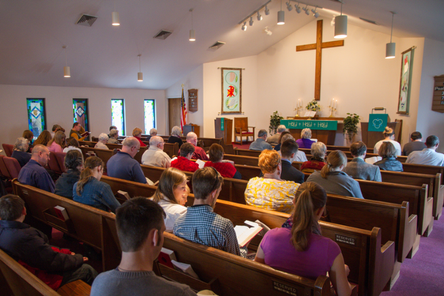
Vision Statement: By God’s grace, in five years we are…
Serving a greater number of people with weekly worship that centers on the gospel in word and sacrament. Worship will be done with excellence and reflect the rootedness and flexibility of the historic Christian tradition. Guests and members will receive a warm welcome and experience the love of Christ not only in the gospel that is proclaimed but in the way we care about and serve each other.

Slide 17
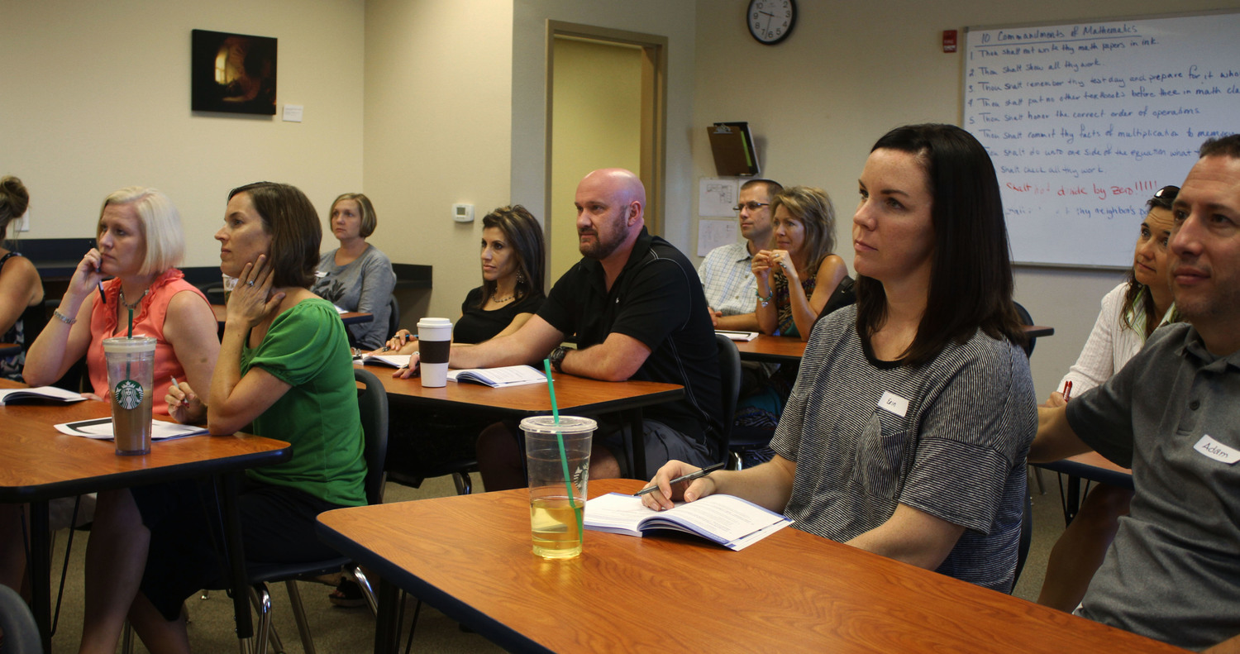
Vision Statement: By God’s grace, in five years we are…
Serving more people with a menu of Bible Classes, sound in doctrine, creatively taught, to equip young and old for leadership and service, specific life challenges, and sharing and living our faith in an increasingly secular world. Well-trained leaders and workers, growing in faith through the Word, will be the key to expanding our ministry, reaching more people with the gospel, and building strong families.

Slide 18
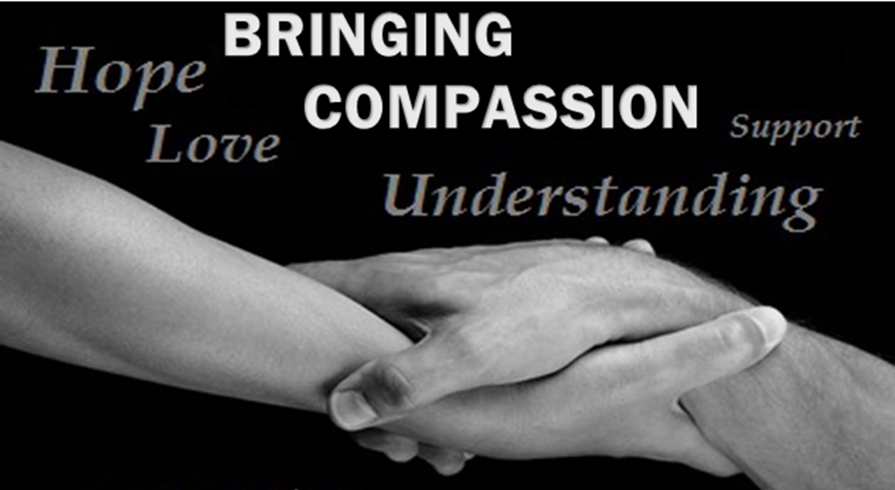
Vision Statement: By God’s grace, in five years we are…
Doing more to show love and support not only to members of our church family, but also to those who are not part of our church family, to the lost, and to the community as a whole. We will do this through supportive relationships, charitable acts, spiritual care, and practical assistance. We will build bridges to the lost with deeds of love and compassion so that we can share the gospel with them.

Slide 19
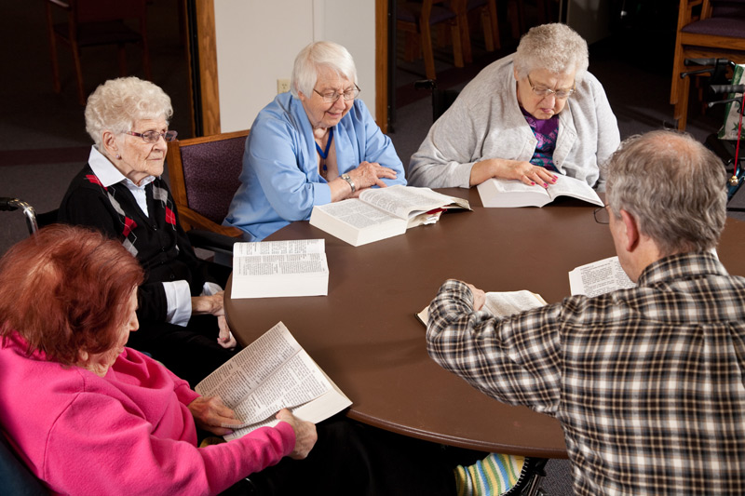
Vision Statement: By God’s grace, in five years we are…
Spearheading efforts in the greater Lansing area to reach and to serve seniors and their families with the gospel of Jesus Christ. We will guide and share resources with WELS churches in the Michigan District who want to reach out to seniors in their communities with Bible classes and worship services.

Slide 20
Vision Statement: By God’s grace, in five years we are…
Gathering in an expanded facility that is able to support our ministry with adequate space for a larger number of worshipers, fellowship events that bring us closer, various classes that benefit children and adults and train us for service and outreach, and events, programs, classes, and groups that reach out to the lost.

