Slide 1
Shepherd Of The Hills
Facility Expansion Meeting

Slide 2
2004 Parish Assistance Consultants
“This church has incredible potential to reach many more souls with the gospel. SOTH can serve as a model congregation for the synod. What would keep that from happening is: 1. Members becoming too comfortable with the size and style of current ministry and complacent about carrying out the great commission. 2. A structure and style of ministry that lacks the organization and purpose of reaching and serving a large number of people. Please always remember whose church this is, who governs the universe, who gave his life to redeem the world and wants all people to be save.”

Slide 3
2004 PA Key Recommendations Action Taken
1. Create a vision for your ministry; 2005
Define staff and space needs
2. Address parking immediately 2009
3. Add staff 2011
4. Find additional land 2015
5. Add space ?

Slide 4
Facility Expansion Team 2013-2015
2013 Council reviews space needs identified in 2005 and presents a proposed process and timetable to congregation
2014 Facility Expansion Committee starts to function;
Mayotte Group begins work on drawings
2015 Drawings completed
450 confirmed members / 551 baptized soul
(Compared to 327/448 in 2005)

Slide 5
Current Ministry Status And Projections
A net gain of 27 confirmed members and 34 baptized souls in the past five years suggests slow but steady growth.
Declining worship attendance (as a percentage of our members) in the last five years is a concern. However, worship attendance increased from 219/week to 229/week the past year, and encouraging faithful worship is a key initiative of 2015-16 ministry plans.
Our giving over the past four years fluctuated between $320,00 and $339,644 (a difference of 6%), which suggests a fairly stable baseline for budgetary planning purposes.

Slide 6
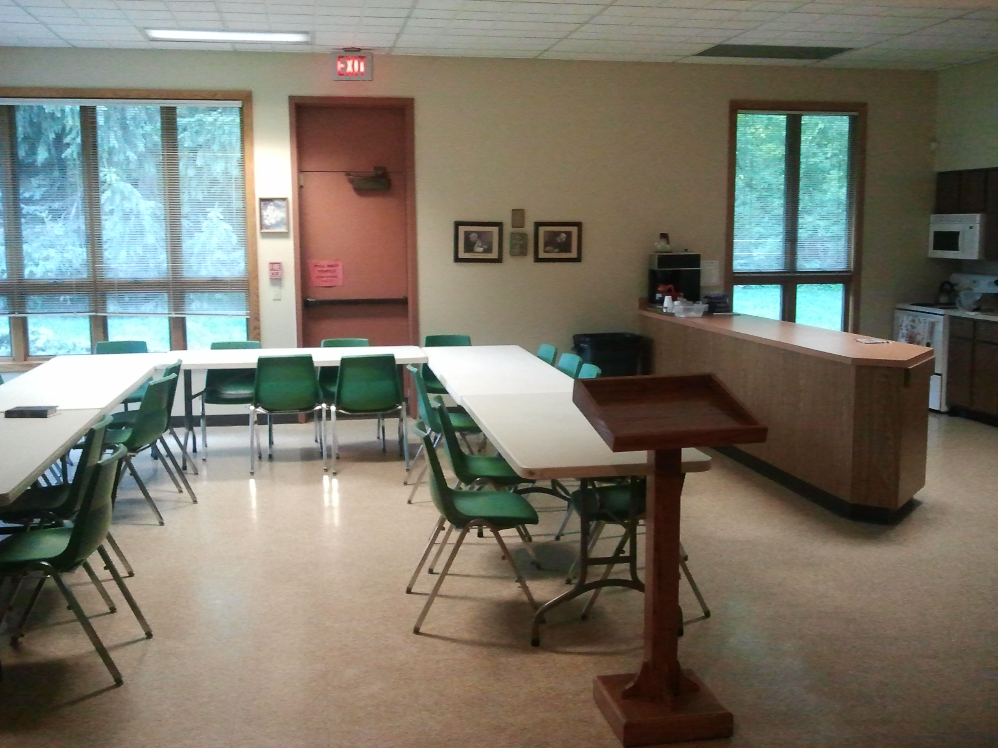
Current Use Of Space: Fellowship Hall NW
Kitchen
Fellowship Gathering
Meals
Youth Ministry Events
Youth Confirmation Class
Workshops
Week Day Bible Classes
Upper Grade Sunday School
Council and Board Meetings

Slide 7
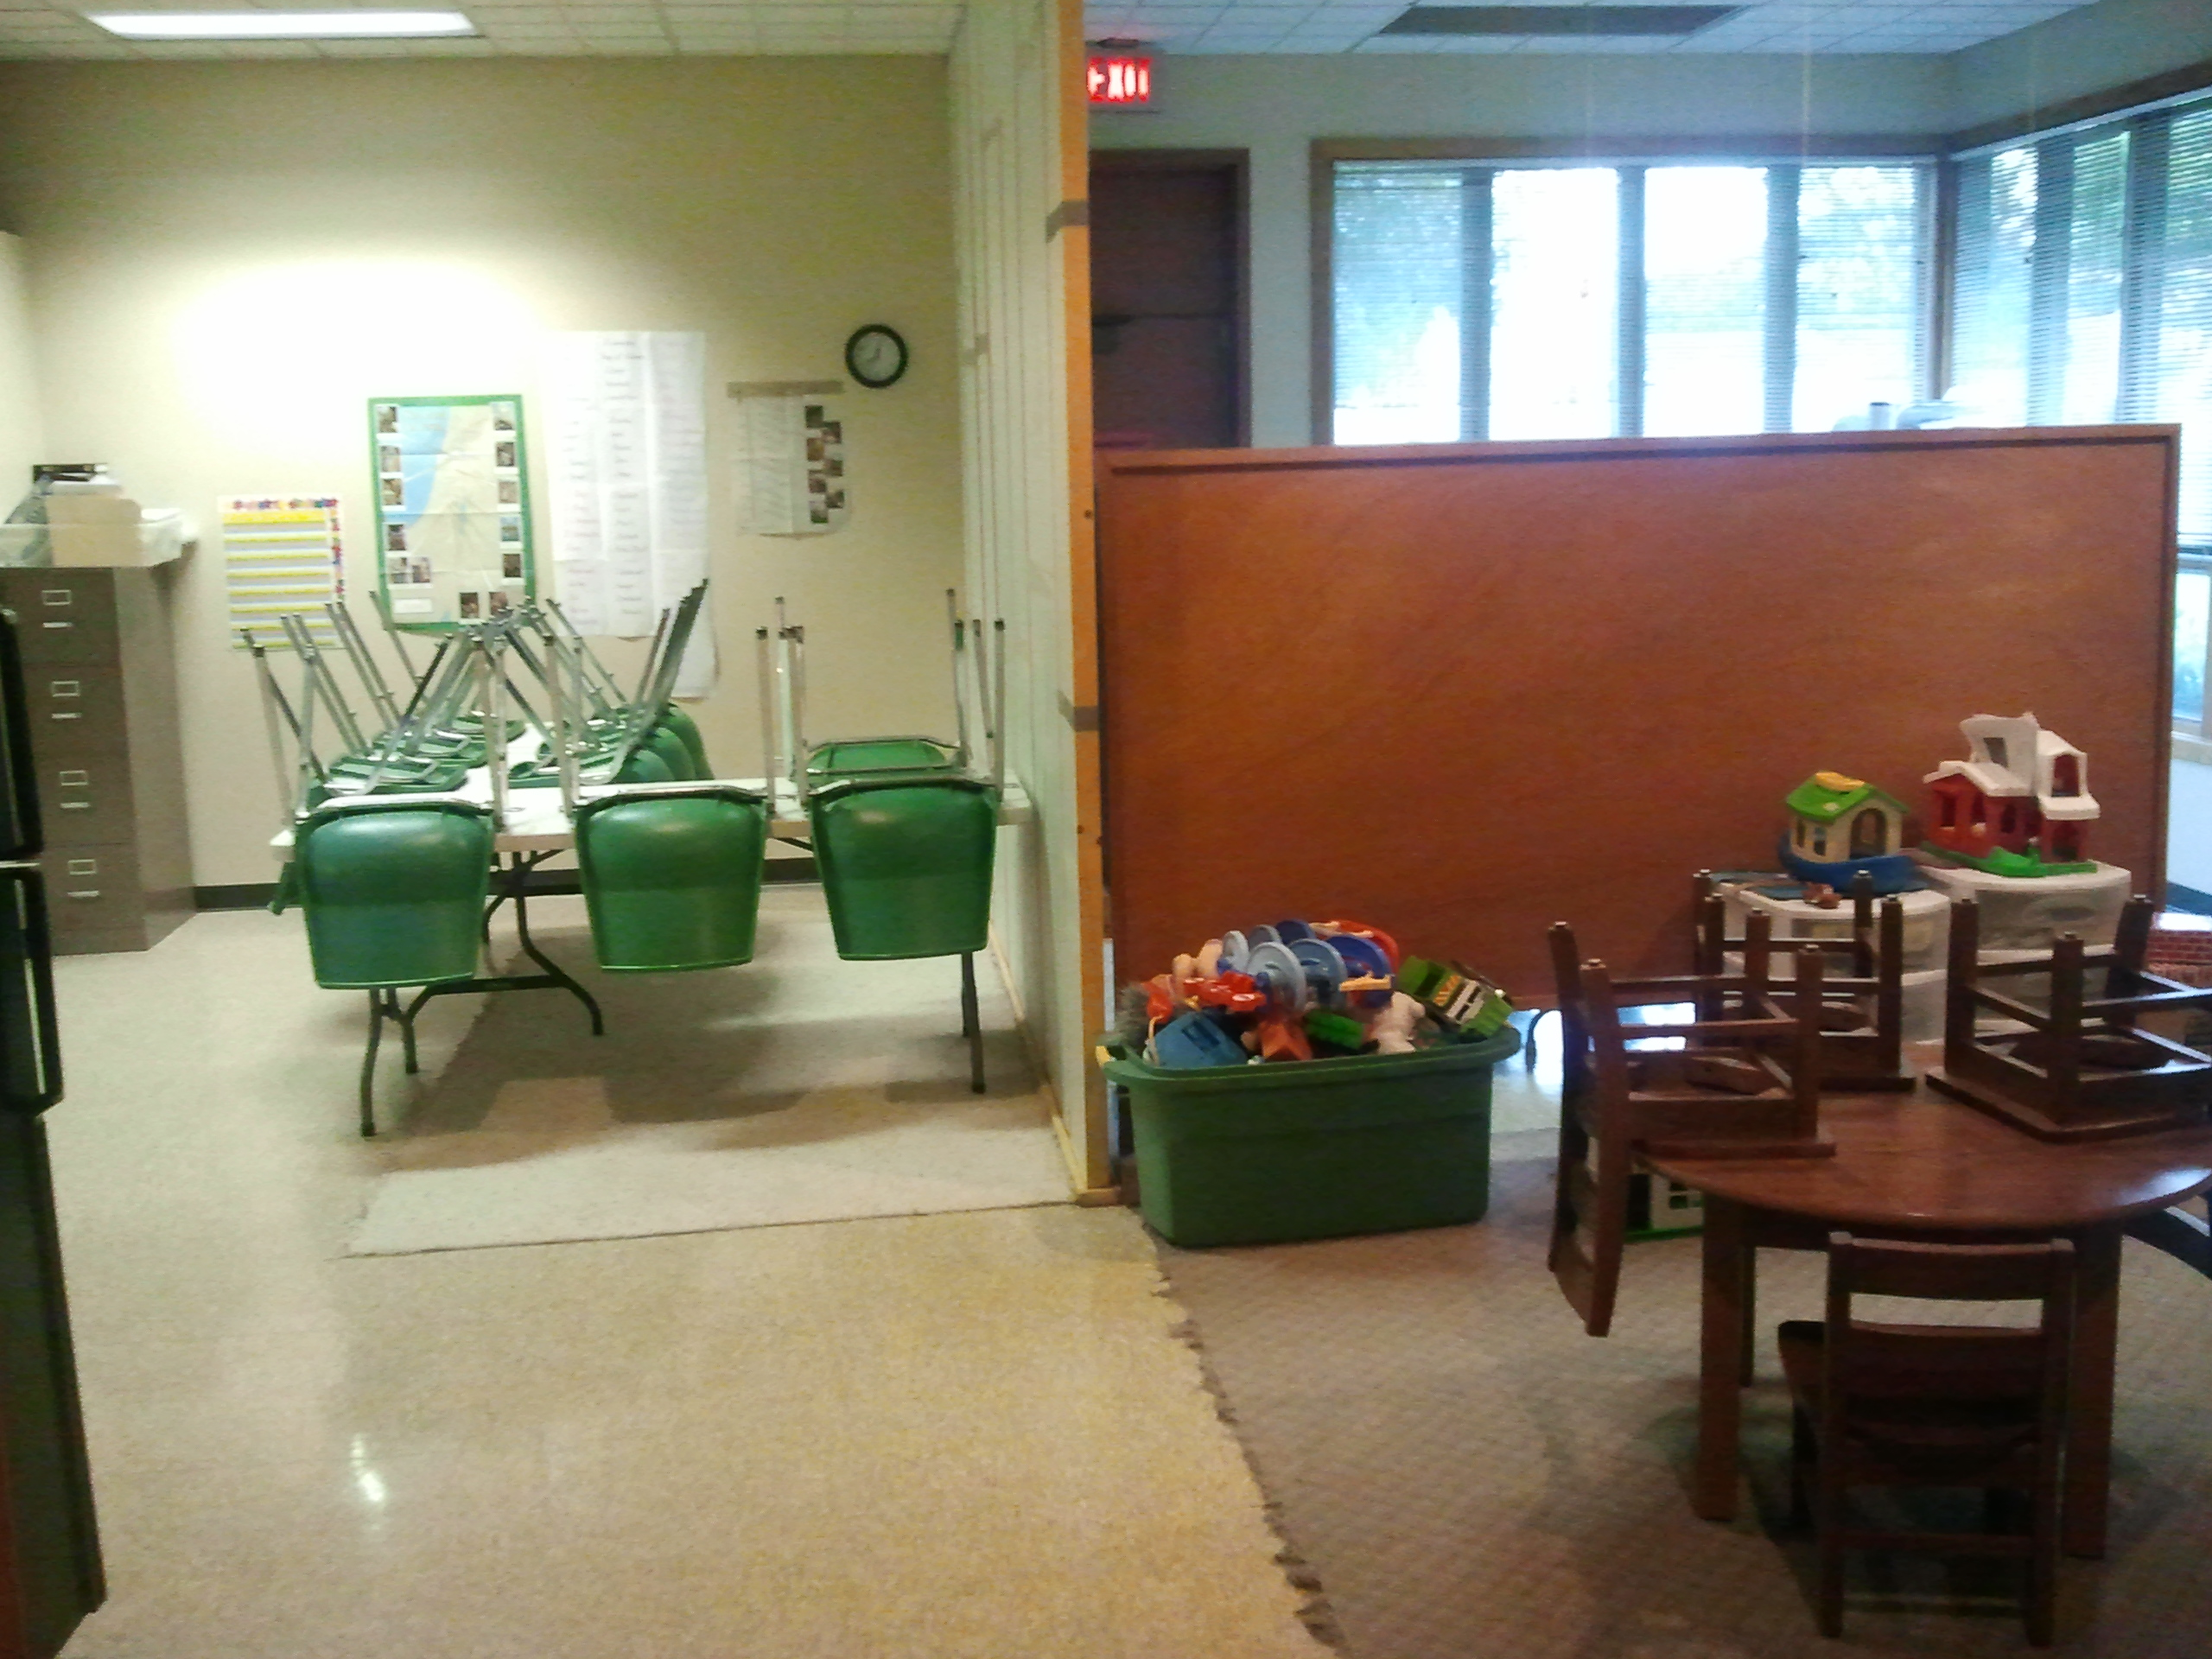
Current Use Of Space: Fellowship Hall SE
Lower Grade Sunday School
Fellowship gatherings
Meals
Storage
Secondary Work Space
Cold Storage For Food Bank

Slide 8
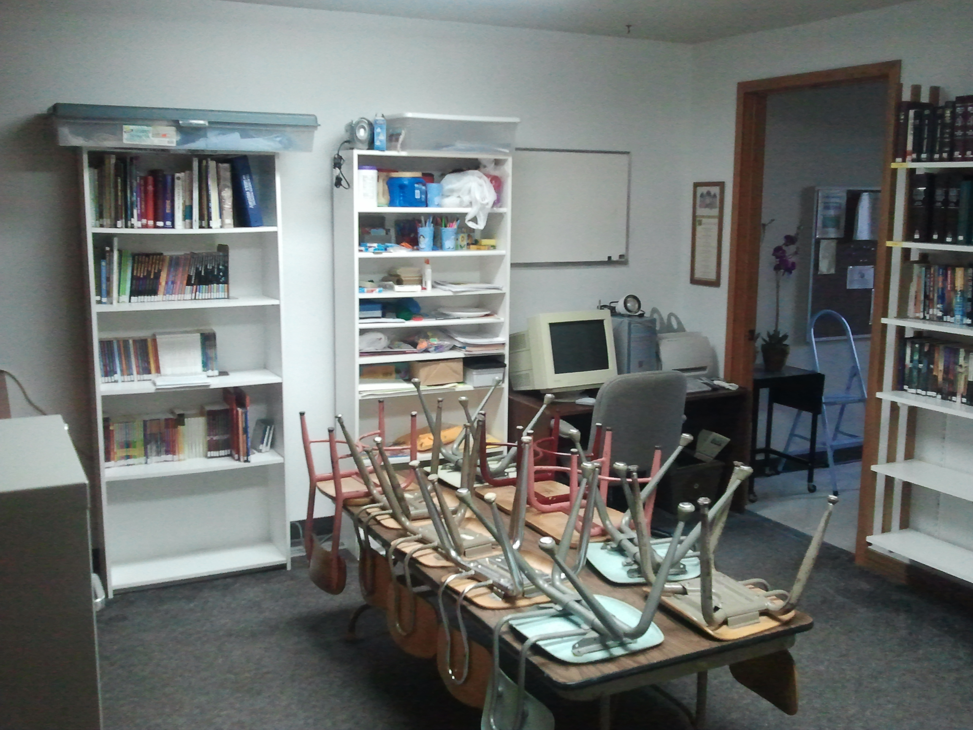
Current Use Of Space: Library
Library
Kindergarten Sunday School
Storage
Taping Of Services

Slide 9
Current Use Of Space: Narthex
Foyer
Before Service Socializing
After Service Socializing

Slide 10
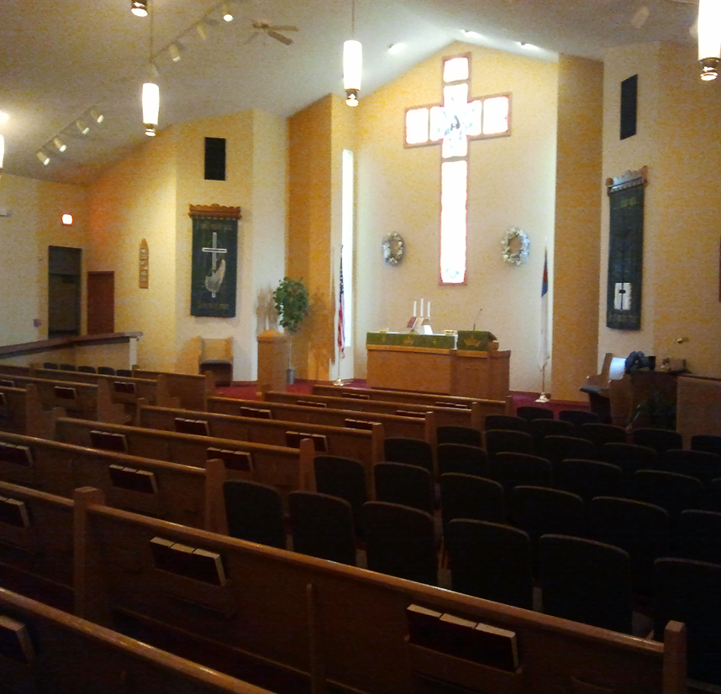
Current Use Of Space: Sanctuary
Worship Services
Adult Bible Class
Women’s Support Group
Choir Rehearsal
Community meetings
(Condo association)

Slide 11
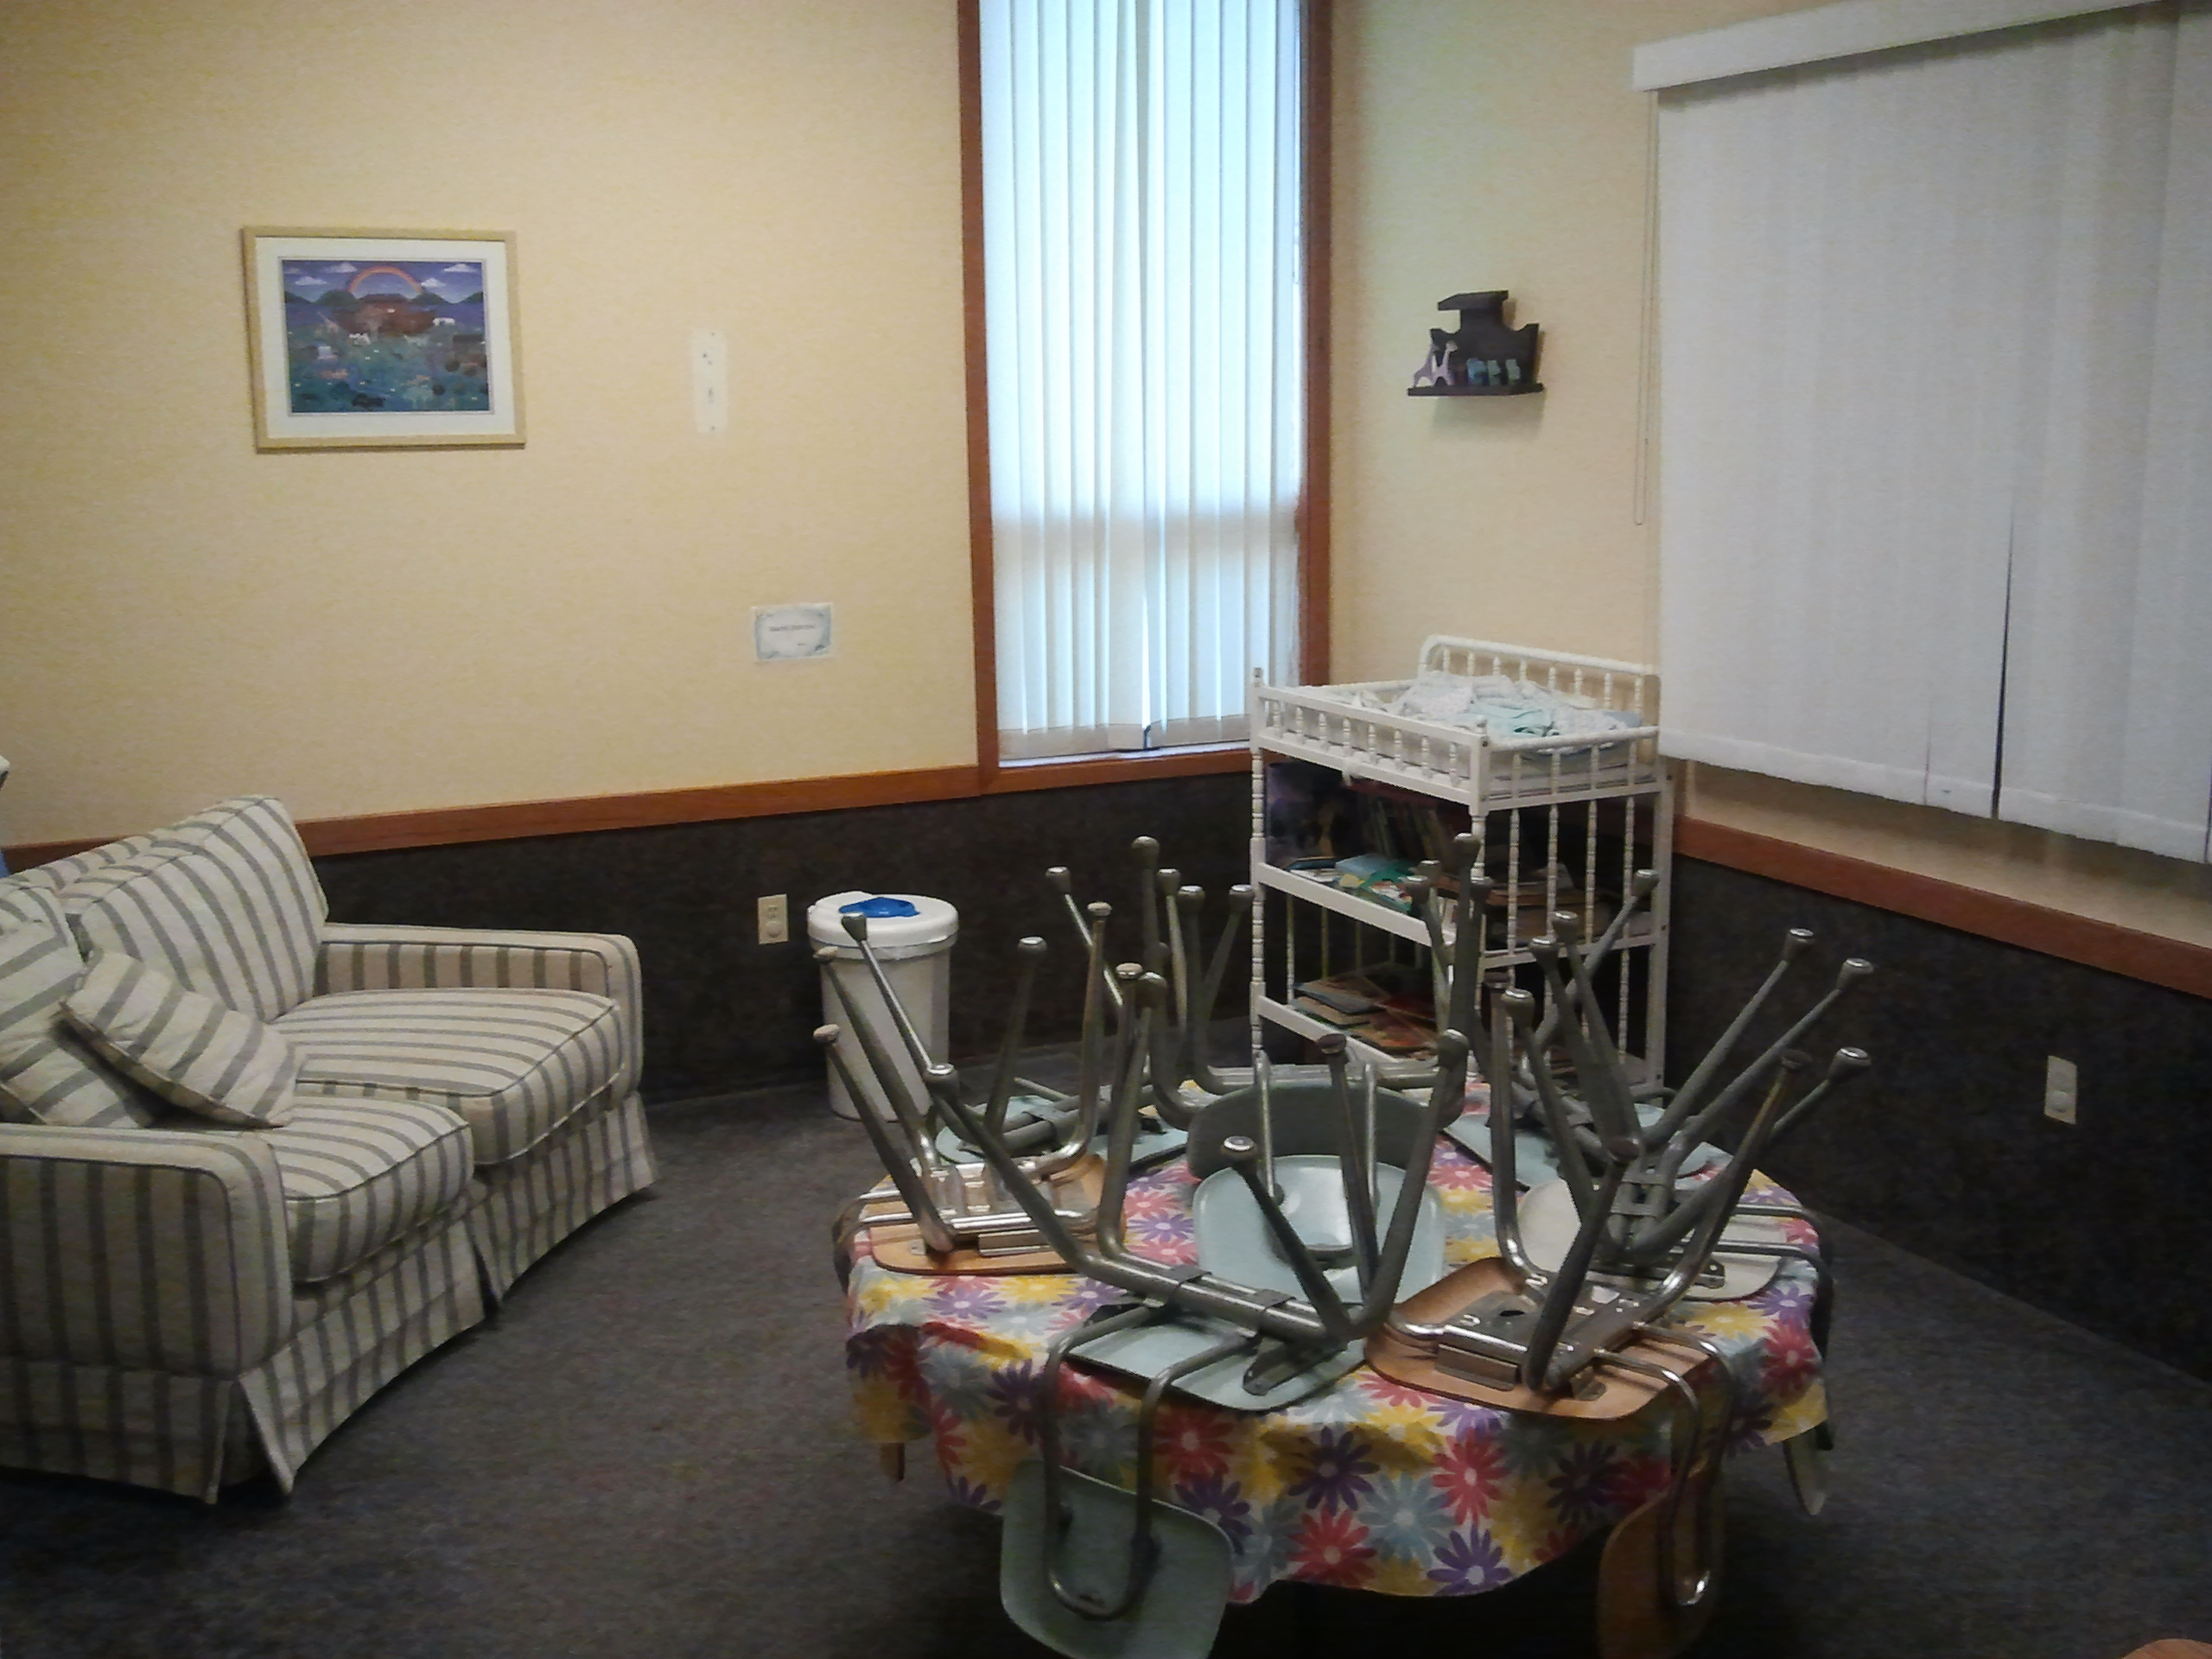
Current Use Of Space: Cry Room
Cry Room
Pre-School Sunday School
Baby-Sitting Space
Family Counseling Room

Slide 12
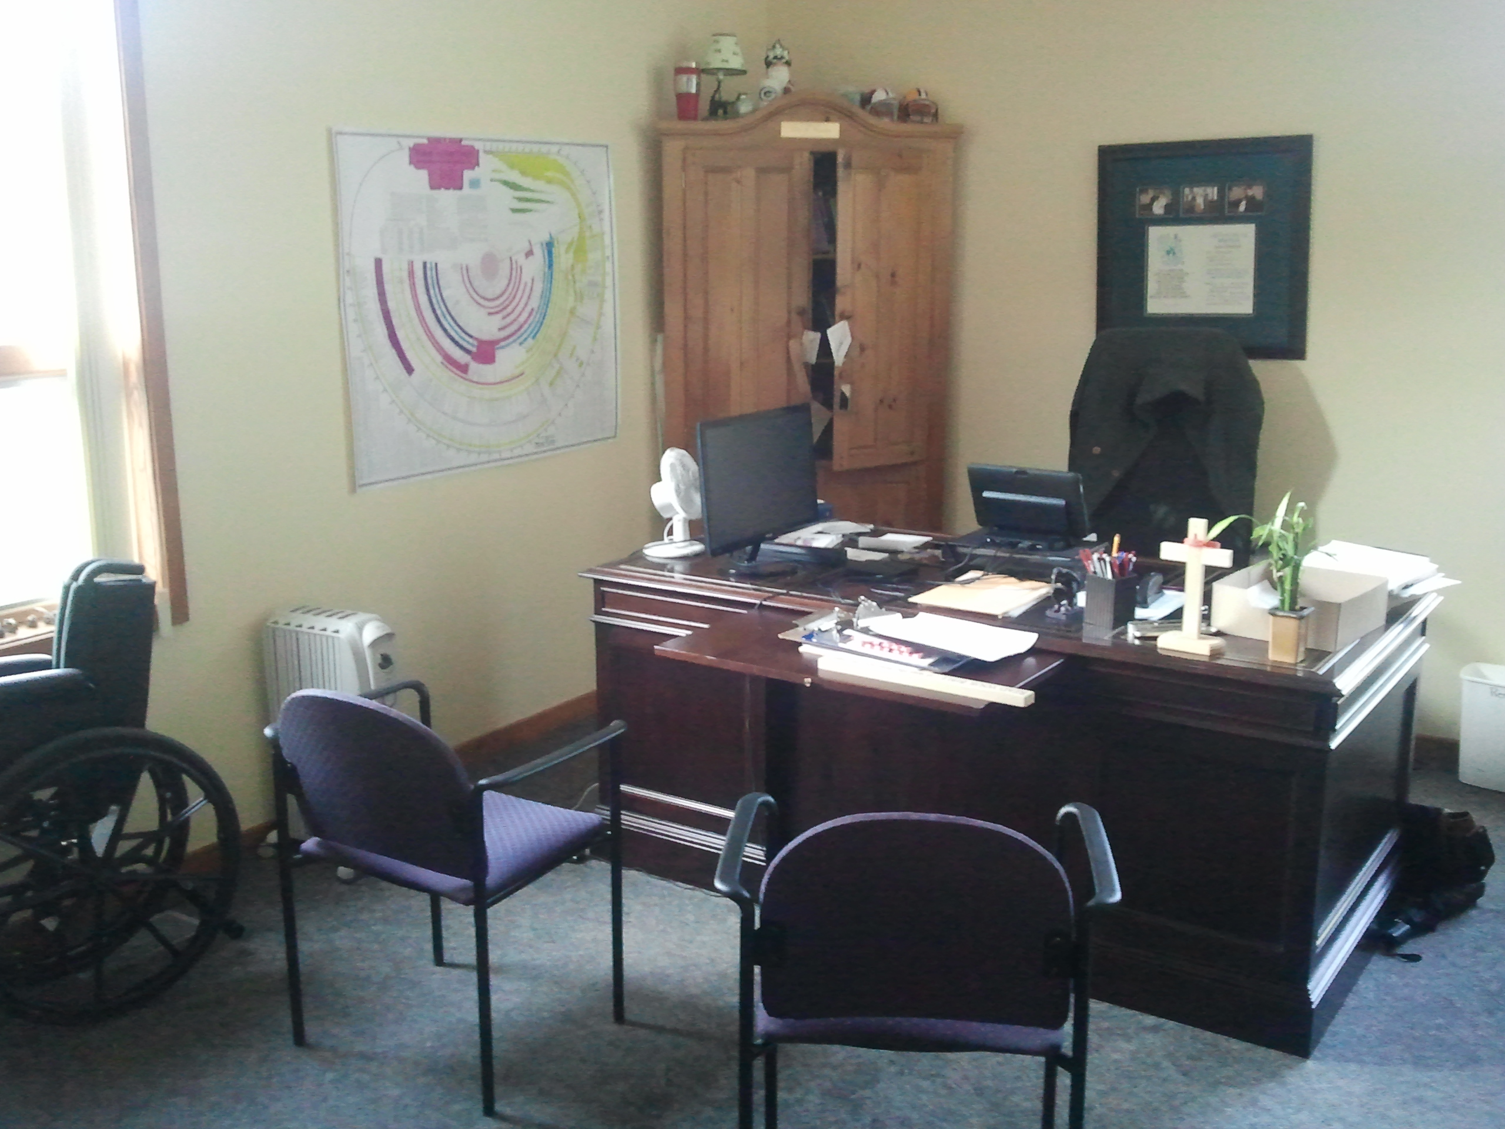
Current Use Of Space: Pastor Tullberg’s Office
Pastor’s Office
Counter’s Meeting Room
Small Group Meetings
Food Bank Storage
Wheel Chair Parking Space

Slide 13
Limitations Of Current Space
Fellowship Hall unable to fully accommodate congregation fellowship activities, outreach events, funeral luncheons, or wedding receptions
Teens lose 20 minutes of Bible study by meeting offsite
Narthex is crowded, noisy, and has poor traffic flow
Teaching and learning is challenging in our current class spaces

